Slide 1
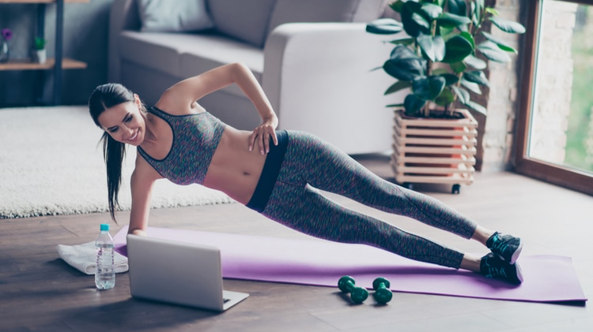
Home Workouts

Slide 2
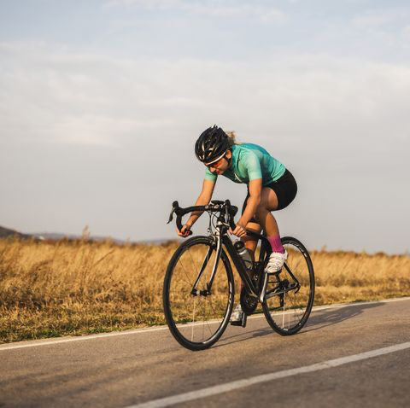
Ways to keep fit at home:
Ways to improvise gym equipment:
Ways to keep fit:
Running
Swimming
Cycling
Strength and conditioning
Resistance bands
Use a chair
Fill a rucksack with books

Slide 3
Running set examples:
Endurance | Sprint ability | Interval training
Pyramid sets | 20m shuttle runs | 15 s on 15 s off
2km repeats | 50m shuttle runs | 30 s on 30 s off
800m repeats | Strides | 2 mins on 2 mins off
5 km – 10 km distance runs | 100m repeats | 3 mins on 3 mins off

Slide 4
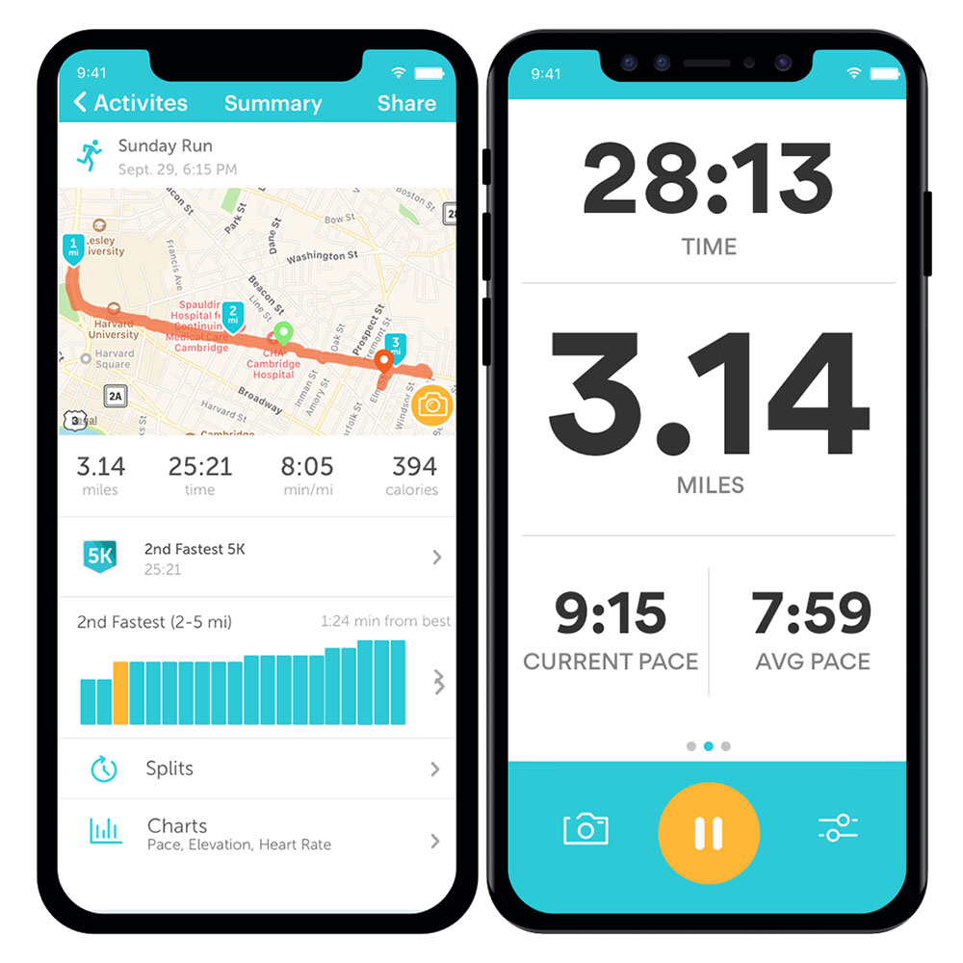
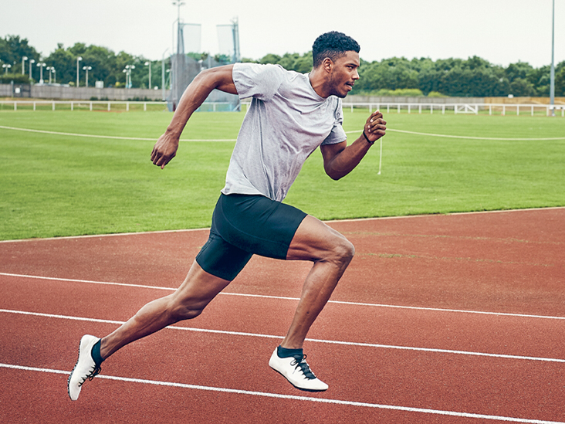
Running apps to record distance, speed and time:
Strava
Run keeper
Couch to 5K
Map my run
Pacer
Nike run club
Run coach
Human
Beep test
Interval timer
Apps aren’t always accurate
If your recording progress then the best way to do this is by planning a route
Save your times for improvement

Slide 5
Core workout exercises:
Plank
Side plank
Leg raises
Crunches
Sit – ups
Bicycle crunches
Dead bug
Hollow hold
Climbers
Toe/knee taps

Slide 6
Core workouts for beginners (10-20 mins):
https://www.youtube.com/watch?v=3XVGDYuPay4
https://www.youtube.com/watch?v=1f8yoFFdkcY
https://www.youtube.com/watch?v=Oa-xdUN3x08
https://www.youtube.com/watch?v=hUHgBg_t1Tw
https://www.youtube.com/watch?v=qfoW2PKugyk
https://www.youtube.com/watch?v=LY5Dp0s4IxI

Slide 7
Harder core workouts:
https://www.youtube.com/watch?v=2pLT-olgUJs
https://www.youtube.com/watch?v=8AAmaSOSyIA
https://www.youtube.com/watch?v=cbCt69XAUKA
https://www.youtube.com/watch?v=-b2lNLq3EaA
https://www.youtube.com/watch?v=dJlFmxiL11s
https://www.youtube.com/watch?v=AssgMcBob5o
https://www.youtube.com/watch?v=sHbW6OPEn6o

Slide 8
Full body workouts:
https://www.youtube.com/watch?v=UBMk30rjy0o
https://www.youtube.com/watch?v=R6gZoAzAhCg
https://www.youtube.com/watch?v=Y2eOW7XYWxc
https://www.youtube.com/watch?v=1skBf6h2ksI
https://www.youtube.com/watch?v=UItWltVZZmE

Slide 9
Calf workout exercises:
Calf raises
Elevated calf raise
Single leg calf raise
Pulsing squat
Jump squats
Box jumps
Bunny hops
Speed ladders
Stair running
You can find programmes online or YouTube videos suited for you

Slide 10
Importance of recovery:
Stretching:
Use a foam roller or lacrosse ball
Use a stretch band
Warm up and cool down before and after exercising to avoid re-injury
Diet:
Eat a balanced diet
Drink plenty of water
Sleep:
Make sure you sleep at least 7 hours
Have a day off – let your body rest and recover

Slide 11
Ways to stay connected
Go on a run with a friend - follow each other on a running app
Take up a new activity or learn a new skill
Join classes online e.g Zumba or fitness
Watch videos online
Join Instagram lives with workouts for free
Keep up your mental health with meditation and yoga – Breethe is a great app for this
There are many ways to adapt to maintain you workout routine whether that’s at home or elsewhere
Just ensure you and others are safe by following the COVID-19 guidelines

