Slide 1
RSE, Festival Fun & Freedom
Amy Forbes-Robertson, BA, MPhil, PGCE, QTS
Healthy Relationships & Positive Sex Education

Slide 3
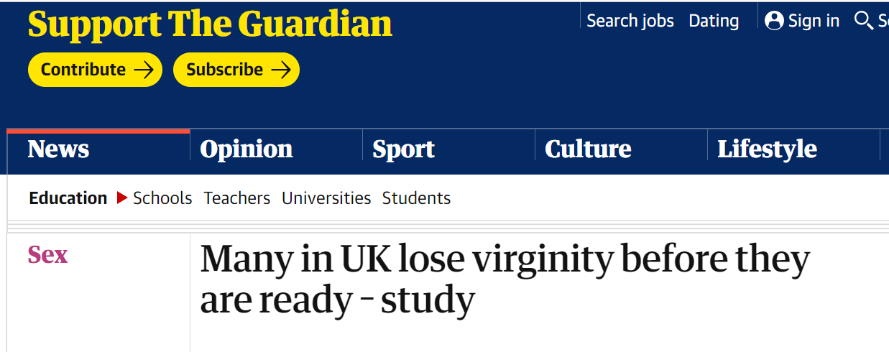

Slide 4
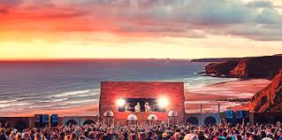
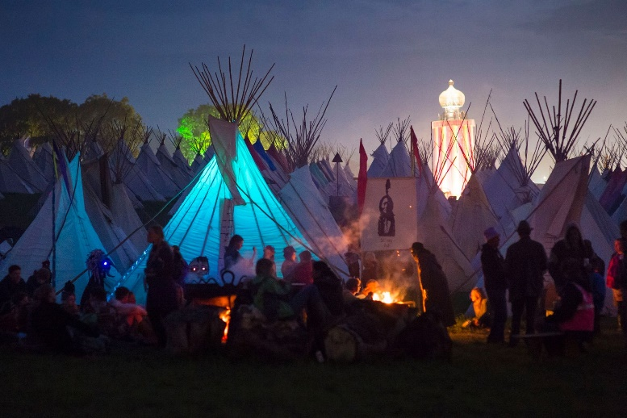
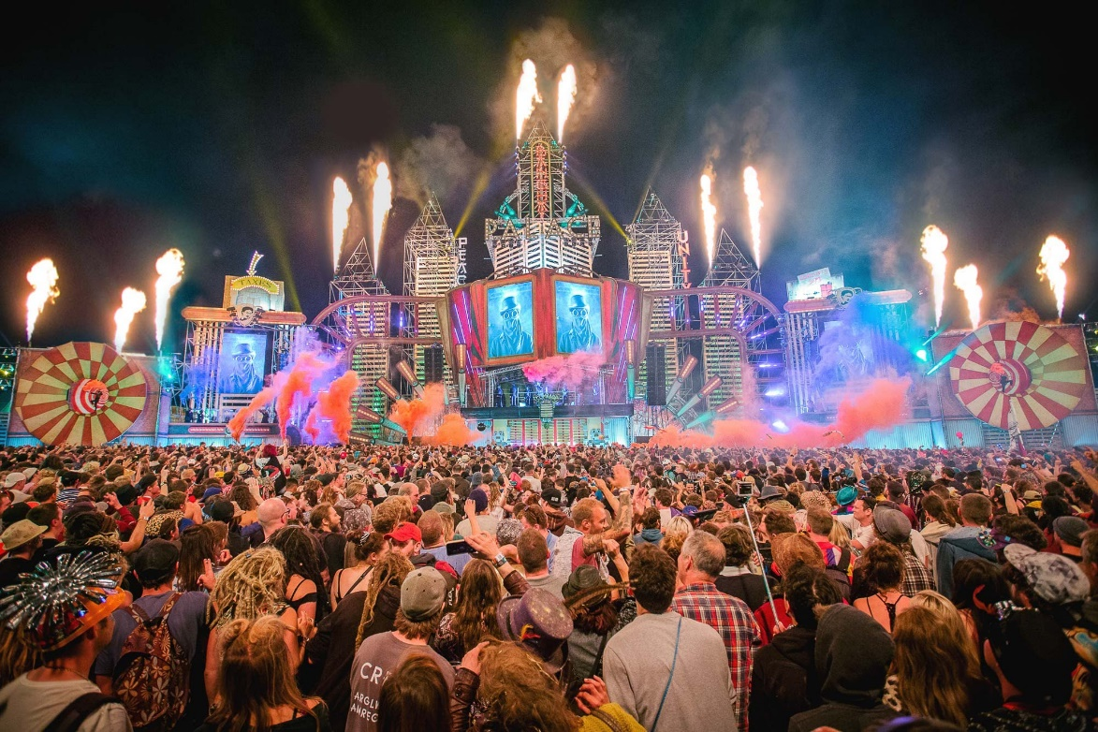
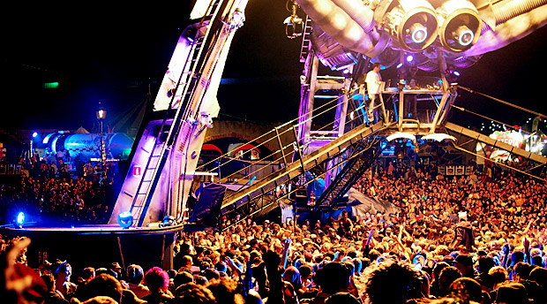
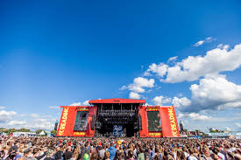
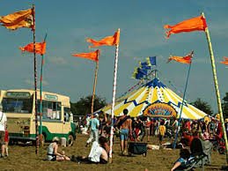
Which Festival?

Slide 5
Which headline?

Slide 6
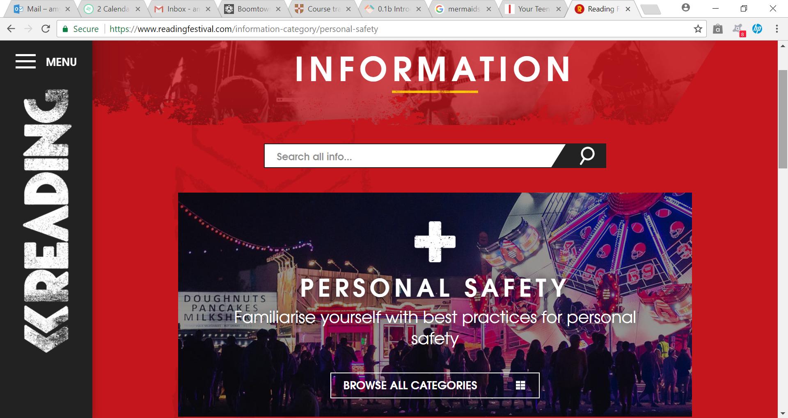
BE PROACTIVE = Do the research

Slide 7
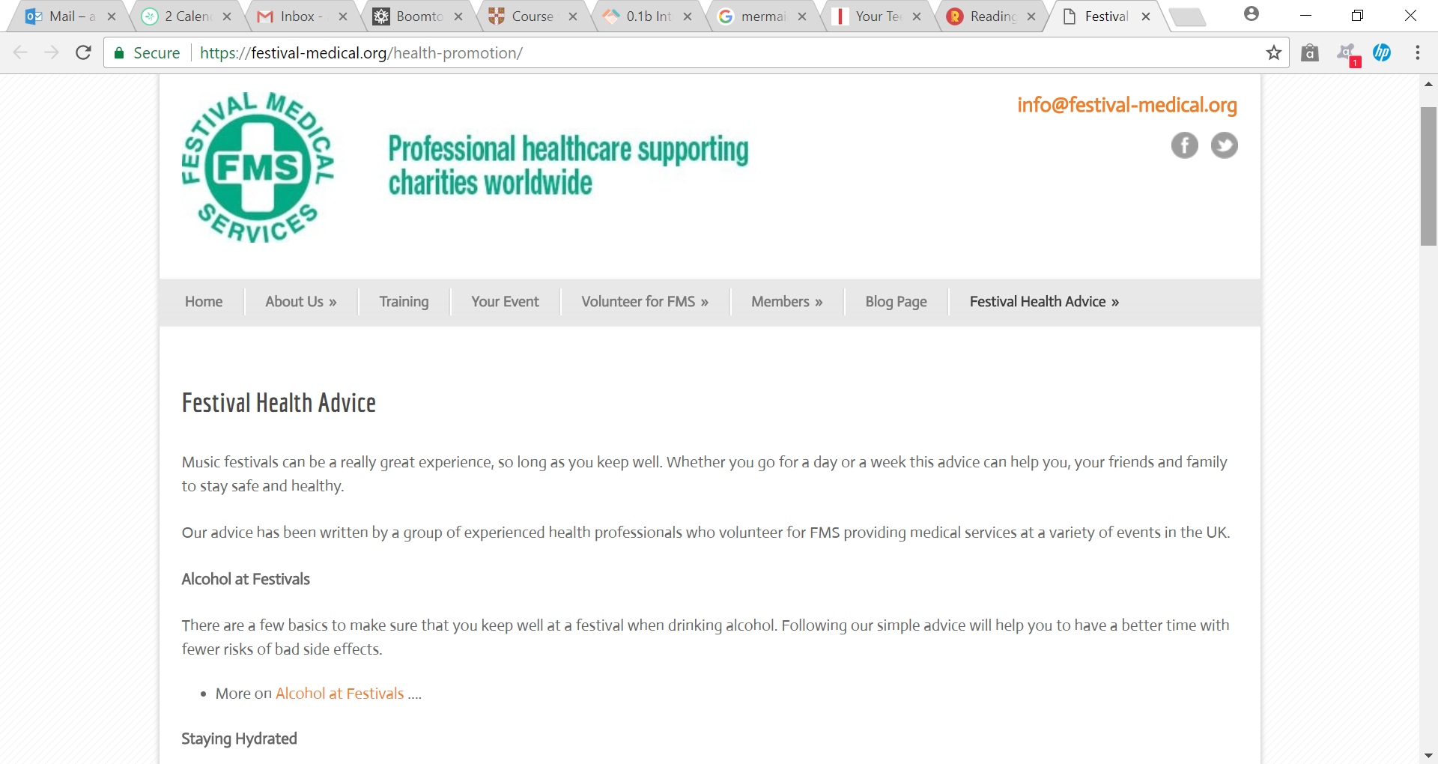
There is so much info available…

Slide 8
Keeping you safe is becoming a big priority…
Festival Safe - https://www.festivalsafe.com/
Safer Spaces http://aiforg.com/aifs-safer-spaces-at-festivals-campaign/ or
A good night out http://www.goodnightoutcampaign.org/ or
Safer Gigs for Women https://sgfw.org.uk/

Slide 10
https://www.youtube.com/watch?v=pZwvrxVavnQ

Slide 12
Boomtown Harm Reduction
https://www.youtube.com/watch?v=kxkO1qrkz9U

Slide 13
Festival Survival Guide
Choose your festival carefully
Choose who you go with
Look after EACH OTHER!
Nightmare friends can ruin it all
Choose where you camp carefully
You have to carry everything!!!
Make a warm secure and tidy home
Learn your way round SOBER!
Mark your campsite on a map and put in your lanyard
Take your own medication with you
Water and food are important
Know your normal
Personal hygiene tips – loo roll, baby wipes, sanitary stuff.
Bad shoes & foot health can ruin it all!
Sex – it happens, but privacy is limited & everyone is filthy. Sort out contraception and always carry a condom.
You need to stick to your routine if you are on the contraceptive pill.
White t-shirts don’t stay white.
Washing is hygienic but optional
Sun burn hurts
It gets cold at night
The mobile phone thing
Stay in touch or don’t stay in touch with home but make sure its AGREED.
Make decisions when you are sober
Try to know what you are getting and where it comes from
Know the risks and make informed choices
Safe environment for your head
Never isolate yourself when drinking/ taking drugs
Don’t let friends go off alone
Being tired makes you emotional
Know when to ask for help
Trust the stewards and police want to help you not to get you in trouble.
Your friends are your safety net
Don’t be a bystander
Step up and help others. Even if you don’t know them!!!

Slide 14
Ask for help when you need it!!!

Slide 15
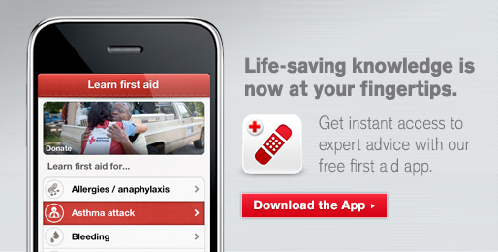
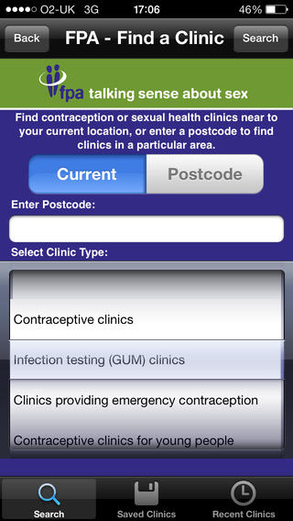

Slide 16
Amy Forbes-Robertson
www.ithappens.education
amy@ithappens.education
alex@alexandrafryer.com

